Slide 1


Построение защищенной финансовой экосистемы
20.10.2017

Slide 2
О Компании

Slide 3

Кто мы
CMA – Шведская компания, офисы во Франции, Канаде и России
27+ лет на рынке решений для финансового сектора
Команда из 100+ сертифицированных инженеров с международным опытом в финансовых системах
Мы специализируемся на внедрении новых решений и обновлении существующих на базе наших кастомизируемых продуктов

Slide 4
Достижения
Наши продукты работают в 50+ странах и 24 временных зонах
Наши клиенты - 37 Центральных банков
1500+ Коммерческих банков используют наши решения
500+ Проектов выполнены по всему миру
$100bln+ Ежедневный объем транзакций

Slide 5
Наша экспертиза
Real-time Gross Settlement System (RTGS)
Central Securities Depository (incl. Clearing and Settlement)
Automated Clearing House (ACH)
Сheque Truncation System
Automated Trading System (including Auction module)
Solutions for Commodities Markets (incl. Trading, Clearing, Settlement)
Transaction Management Systems and STP-enablers
Instant Payments (incl. Online Clearing and Bill Payments)

Slide 6
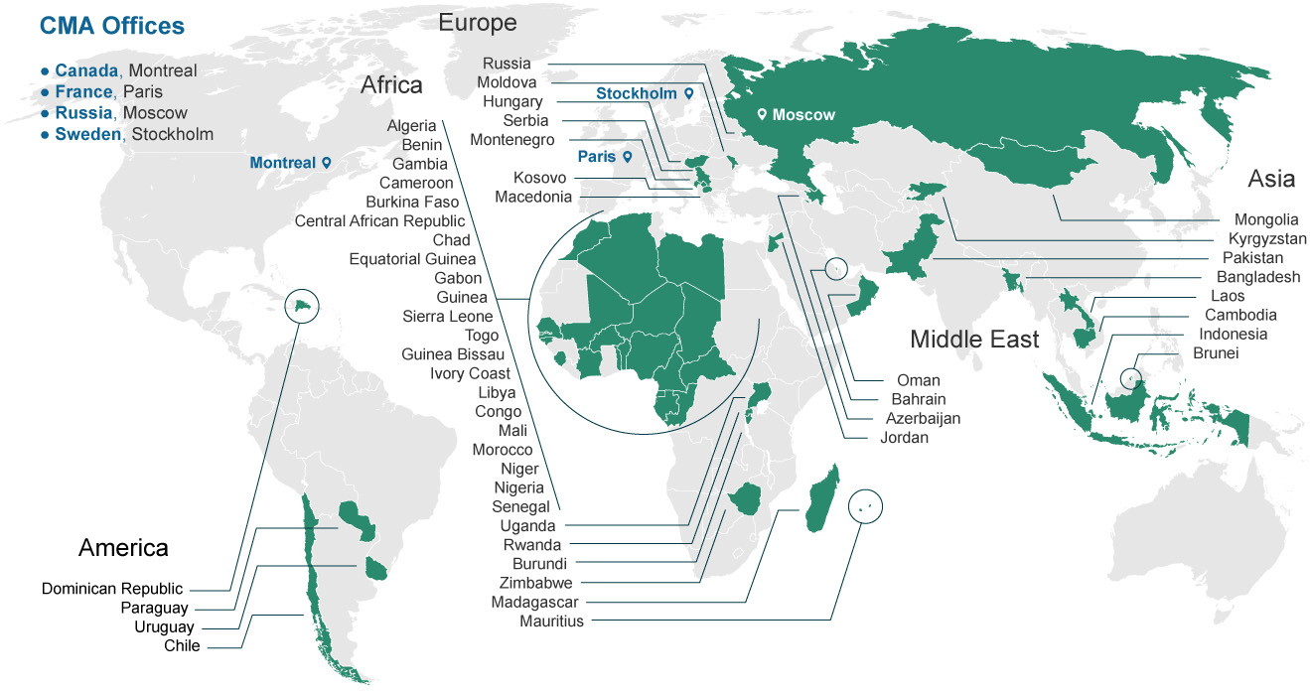
Присутствие в мире

Slide 7



Национальная финансовая экосистема
CMA solution designed considering rich experience in national payment systems. It is not only about payments. It is about financial products and building national payment ecosystem.
RTGS
Trading
ACH
Payment Gateway
CSD
Online Collateral Management
Cheques Truncation
Wage
protection
TMS/X

Slide 8

CMA Unified Engine
Technology Highlights
Cross-platform Java application compatible with major application servers (Tomcat, WebLogic)
In-memory database automatically synchronized with permanent storage (Oracle RDBMS)
Well defined API for transaction and information requests (push)
High-performance (1000 trx/sec with avg processing time < 50 ms)
High-available 24/7 Operation Mode with typical availability 99,99%
Messaging ISO20022, ISO150022, FIX, ISO
Configurable modes of Operation (Technical)
Processing Engine (Active-Active)
Gateway (Active-Active)
Configurable modes of Operation (Functional)
RTGS (RTS/X)
ACH (BCS/X)
Instant Payments (EFTS)
CSD (DEPO/X)
ETP with Auction Module (TRAD/X)

Slide 9









CMA Unified Engine
Telecom
Transport
Money Transfer
Government
Utility
BANKS
RTGS
Financial Cloud
Corporates
Cheques
CSD
DNS
EFTS

Slide 10
Unified Engine to build a solution
Number of servers depends on performance requirements & organizational structure
Access servers can be accessed via single address (IP/DNS)
Transaction from participant automatically routed to proper application server if required
Access servers can be accessed by external system, financial (bank & non-bank ) and non-financial organization
Information published by application servers in on-line mode (push notification)
Participants,
External Systems
External System
(Stock Exchange)
External System
(Biller)
External System
(PSP)
3rd Tier
Access Servers
External System
(Government)
2nd Tier
Servers (Routers)
External System
(Comm. Bank)
International Settlement
1st Tier
Application Servers
SWIFT

Slide 11




Advanced participant module (TMS/X)
Bank Head Office & Branches
Solution Highlights
Transaction
capture and workflow
Monitoring
Enables STP for payments and messages
Administrative
Workstations
Hides unnecessary functions
TMS/X
External Systems
Aggregates and segregates payments
Payments
Messages
Workflow
Internal Systems
Converts message formats
Cheques
Batching
MT<->MX
STP
Core Banking, Treasury,
Salary,
eBanking, etc.
Database
RTGS, ACH/NRT, CSD
Facilitates reconciliation
Pre-validation and additional authorization
Transaction capture and workflow
Monitoring and Control
Workstations at Bank’s Branches
Extendable modular architecture (plug-ins)

Slide 12

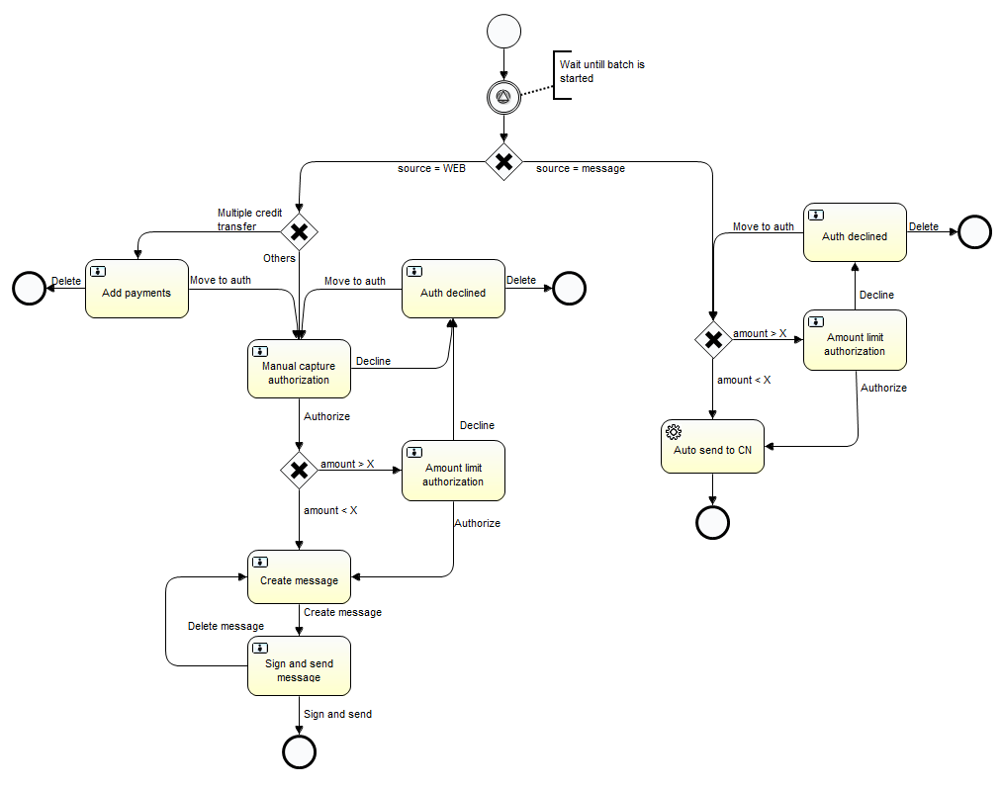
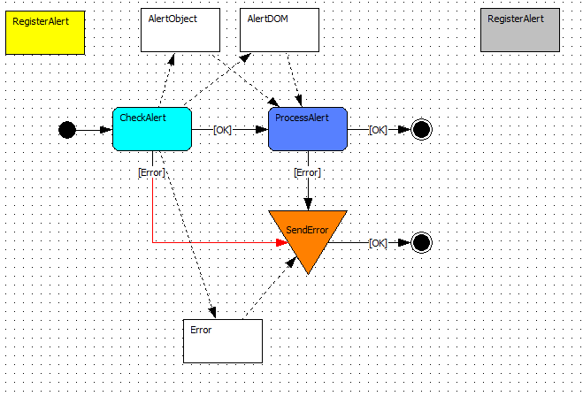
Business Processes Management
TMS/X
Central Application

Slide 13
One to rule them all
Single Point of Access
Configurable
Single point of access to financial services
Functional and technical operational mode is configurable without application re-installation
Unified API
Scalable
Unified API & message standard available for financial and non-financial institutions
Number of servers can be adjusted based on performance requirements & organizational structure
High-Available
Regional & International
24/7 operational mode with 99.99% availability by utilizing A/A software clusters
Ready for ASEAN & International integration

Slide 14
Evolve financial system
PHASE ONE
SECOND PHASE
Near Future
Future
Single service or several
Services (Instant, ACH etc)
More instruments and participants
Additional services
Established ecosystem/Financial Cloud

Slide 15
TMS/X IN STANDALONE MODE
Bank Head Office
Transaction capture and workflow
Monitoring and Control
Administrative
Workstations
TMS/X
External Systems
Payments
Messages
Workflow
Internal Systems
Securities
Batching
MT<->MX
EBPP
NRT
Database
PNG/X, EFTS*
Core Banking, Treasury,
Salary,
eBanking, etc.
Transaction capture and workflow
Monitoring and Control
Workstations at Bank’s Branches

Slide 16
TMS/X
BUSINESS BENEFITS
SOLUTION HIGHLIGHTS
Increases STP level
STP enabler for financial transactions
Minimizes enhancements of legacy systems
Aggregates and segregates payments
Mitigates transformation risks
Lowers time-to-market
Converts message formats
Increases productivity
Pre-validation and additional authorization
Reduces traffic
Facilitates reconciliation
TECHNICAL BENEFITS
Online monitoring
Future-proof technologies
Built-in BPM and Tasks engines
Flexible and scalable architecture
Choice of supported OS, AS and DBMS fits your IT expertise and skills
Extendable modular architecture (plug-ins)
Easy to support and upgrade
Notes:
TMS/X can fully simulate STPA/STPG, no human intervention is required for message exchange (send/receive) process
Manual transactions capturing (“maker-checker” is available)
Reconciliation, Audit, Monitoring and Reporting facilities
Built-in Monitoring facilities

Slide 17
FOCUS POINTS: KEY CONCEPTS
Advanced integration and STP facilities
Advanced GUI for manual input (No need for SWIFT Terminal for manual input)
Reporting, reconciliation and seamless network switchover
Availability of security mechanism to ensure digital signing/verification
Flexible and very competitive pricing
Future-proof investment considering
  Universal Payment HUB
  Integration to GCC payments environment

Slide 18
COST SAVING WITH TMS/X
Native SWIFT interface support
Flexible payment authorization within TMS/X (no need for SWIFT terminal)
Online network switchover management (VPN<->SWIFT)
Pre-validation and preventive controls reduces unneeded traffic
Easy deployment within existing banks infrastructure
Low total cost of ownership due to minimum infrastructure investment
Same vendor of central node system reduces risks of project overruns

Slide 19
ADVANCED INTEGRATION and STP FACILITIES (1/2)
TMS/X is capable to interface with Your CBS and other internal systems
Any protocol
Any format
Integration can be done on different levels:
Payment or accounting entries level
Capture Forms level (support of CIF etc.)
Integration with CBS as a part of unified payments execution process (exceptions monitoring and decision making from TMS/X GUI with subsequent reflection in CBS)

Slide 20
ADVANCED INTEGRATION and STP FACILITIES (2/2)
  TMS/X adopts universal industrial integration framework which opens possibilities to implement any integration scenarios with almost any available protocol and format.
  Some of them are:
  AHC, AMQP, APNS, Atom, Avro, AWS, Bean, Box, Browse, Cache, Class, CMIS, Cometd, Context, ControlBus, CouchDB, Crypto, CXF, DataFormat, DataSet, Direct-VM, DNS, Disruptor, Dropbox, EJB, ElasticSearch, Spring Event, EventAdmin, Exec, Facebook, File, Flatpack, FOP, FreeMarker, FTP, FTPS, GAuth, GHttp, GLogin, GTask, GMail, Geocoder, Google Guava EventBus, Hazelcast, HBase, HDFS, HDFS2, HL7, Infinispan, HTTP, HTTP4, iBATIS, IMAP, IMAPS, IRC, JavaSpace, jclouds, JCR, JDBC, Jetty, JGroups, JMS, JMX, JPA, Jsch, JT/400, Kestrel, Krati, Language, LDAP, LinkedIn, Log, Lucene, MINA, MINA2, Mock, MongoDB, MQTT, MSV, Mustache, MVEL, MyBatis, Nagios, Netty, Netty HTTP, Openshift, OptaPlanner, Pax-Logging, POP3, POP3S, Printer, Properties, Quartz, Quickfix, RabbitMQ, Ref, Rest, Restlet, RMI, RNC, RNG, Routebox, RSS, Salesforce, SAP NetWeaver, SEDA, SERVLET, SFTP, Sip, SIPS, SJMS, SMTP, SMPPS, SNMP, Solr, Spark-rest, Splunk, SpringBatch, SpringIntegration, Spring LDAP, Spring Redis, Spring Web Services, SQL, SSH component, StAX, Stream, Stomp, StringTemplate, Stub, Test, Timer, Twitter, Validation, Velocity, Vertx, VM, Weather, Websocket, XML Security, XMPP, XQuery, XSLT, Yammer, Zookeeper, Component, ActiveMQ, ActiveMQ Broker, Activiti, Couchbase, Db4o, Esper, Fabric AMQ, Fabric Fabric, Fabric Master, Hibernate, JBI, JCIFS, NMR, RCode, Scalate, Smooks, Spring Neo4j, VirtualBox, ZeroMQ
TMS/X Customers can configure integration component either:
by themselves without CMA involvement
or delegate it to CMA
Notes:
Apache Camel

Slide 21
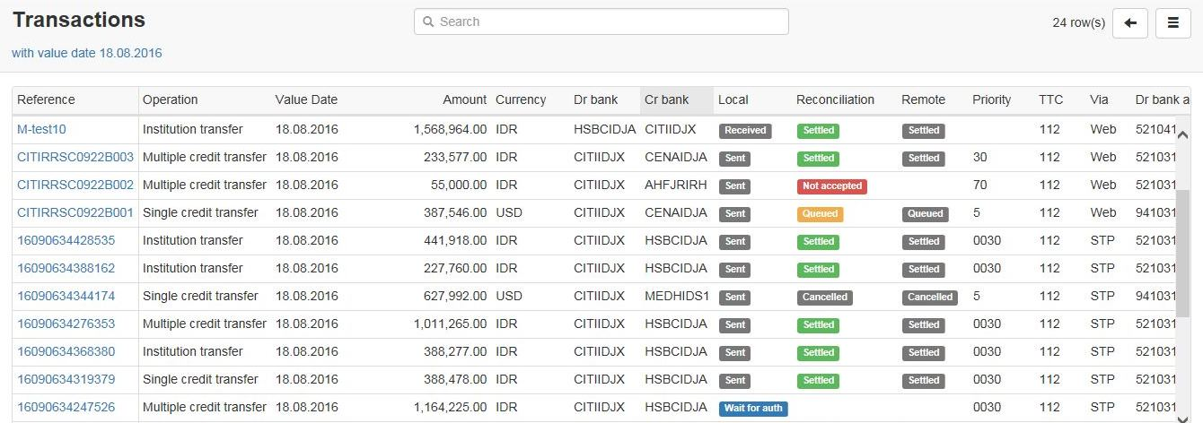
ADVANCED GUI FOR MANUAL INPUT AND MONITORING

Slide 22
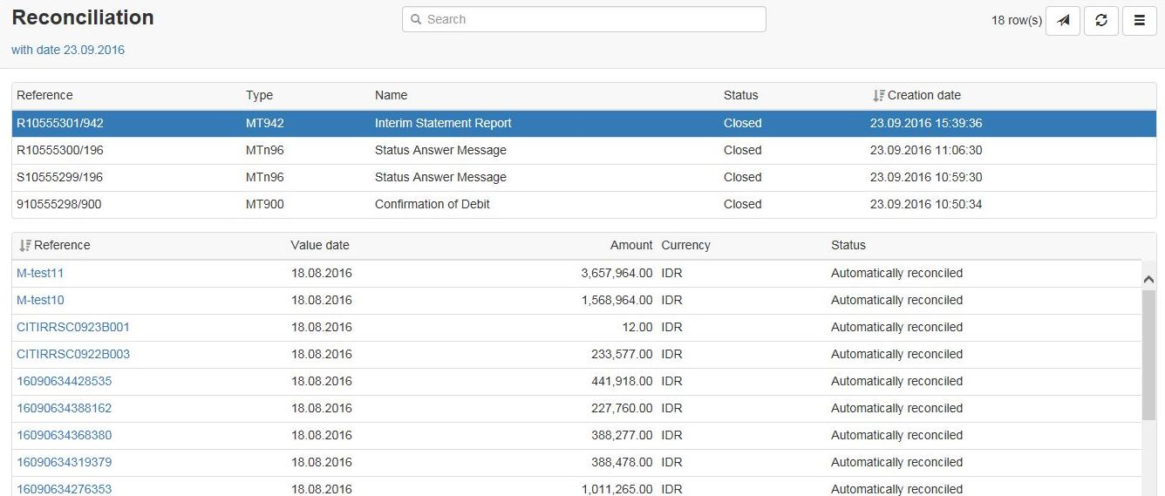
ADVANCED GUI FOR MANUAL INPUT AND MONITORING

Slide 23
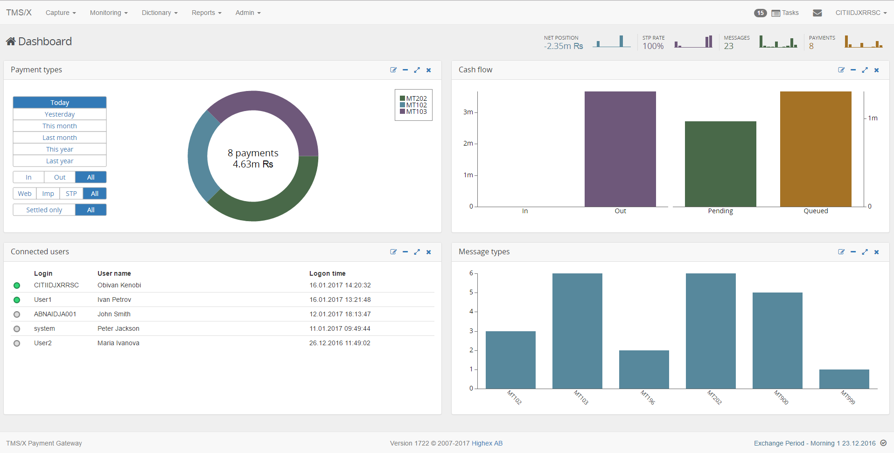
ADVANCED GUI FOR MANUAL INPUT AND MONITORING

Slide 24
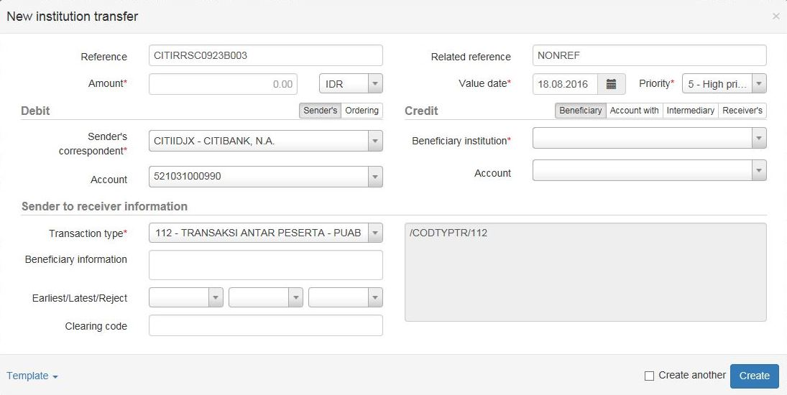
ADVANCED GUI FOR MANUAL INPUT AND MONITORING

Slide 25
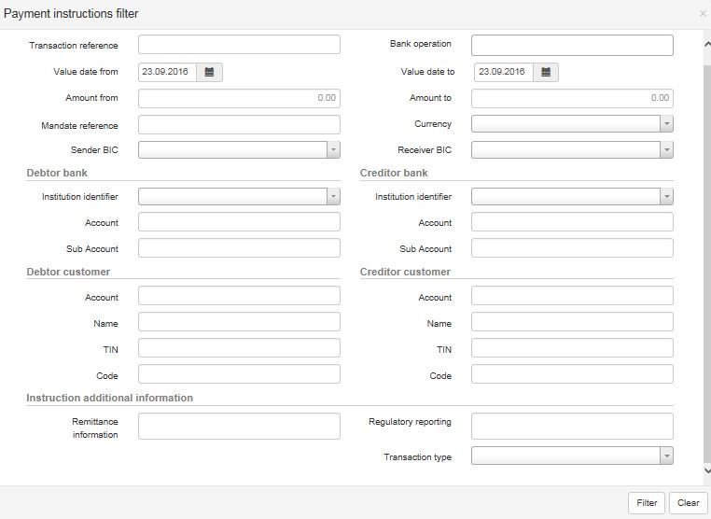
ADVANCED GUI FOR MANUAL INPUT AND MONITORING

Slide 26
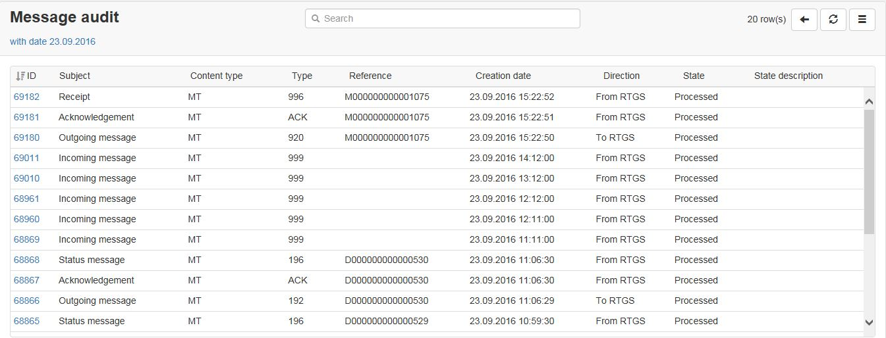
ADVANCED GUI FOR MANUAL INPUT AND MONITORING

Slide 27
REPORTING
Graphical report designer
Built-in engine for custom reports (jasper reports)
Supported formats: PDF, RTF, XML, XLS, CSV, HTML, text, DOCX, OpenOffice
Possibility to use external reporting solution (BI for example)
Detailed local data base schema documentation is provided
Standard package includes
Report on settled payments
Report on rejected and cancelled transactions
Internal payments report
Message exchange report
Information security reports:
Local user activity report
Failed login report
Granted user authorities report
Lost password change report
User login status report
Users audit trail
Periodic review

Slide 28
RECONCILIATION
Provides complete audit trail for processed financial transactions
Online monitoring
Facilitates reconciliation between
TMS/X and PNGX/EFTS
TMS/X and CBS or other internal system

Slide 29
VALIDATION AND CONTROL MECHANISMS
Validation against Business Day Schedule
Automated sync of Business Day Schedule
Pre-collection of Payments/Security transactions until PNGX/EFTS services become available
Block of Payment/Security transactions exchange if Settlement service is not available
Validation against Master data of PNGX/EFTS
Based on automatic sync of Master Data with PNGX/EFTS systems
Validation includes:
Participant codes
Instrument codes
Transaction Type Codes
Business Day window
Customer details validation (optional)
Supports
Import of Customer database into TMS/X database
Validation of Customer details of in incoming/outgoing messages (Payments, Security transactions)
Dedicated validation and control mechanisms to minimize number of processing errors at PNGX/EFTS

Slide 30
MULTIPLE AUTHORIZATION OF MESSAGES
Advanced configuration supports:
Per payment/security transaction attributes:
  Amount
  Source
  Customer
Number of authorization steps are configurable per each case
Users eligible for authorizations are configurable

Slide 31
LOCAL USERS MANAGEMENT
Allows create Local Users non-registered in Central Node databases with their roles and responsibilities
Maker
Checker
Authorizer
Report Manager
Monitoring
Roles are configurable
One User can be assigned with several roles

Slide 32
SUPPORT OF SECURITY INFRASTRUCTURE
TMS/X in STP mode may create signature of BLOCK4
in addition to
Signature of full message
Might be required by CBB as mandatory option to secure STP process

Slide 33
ADDITIONAL PLUG-IN MODULES
MT-MX Format Converter
Allows faster implementation of ISO 20022 XML-based services, messages and payments.
Internal systems supporting ISO 15022 standard require no modification in this case.
Scope of message types supported covers requirements of Central System interaction with participating Banks.
Bank’s proprietary message format can be supported as a part of customization.
Fraud Detection
The module provides online monitoring of payments against configurable set of conditions defined by TMS/X dedicated User on Customer level
Performs offline analysis of payments against configurable set of conditions
Allows “stop” or “warn” of suspicious payments,
Provides detection reporting and alert facilities.
Anti-Money Laundering
Provides online checks against watch lists uploaded into TMS/X database from any source,
Online search of Customer data in this watch list(s) against pre-defined criteria.
Can be integrated with Customer database that may be uploaded to TMS/X.
Provides detection reporting and alert facilities to TMS/X administrator.
The module can be provided as an adaptor to existing AML system.
Correspondent Banking
Allows send/receive payment messages in any currency to/from Correspondent Banks via SWIFT network
Allows send/receive statement reports and settlement advices to/from Correspondent Banks via SWIFT network.
The module can be further extended to support Remittances services.

